Slide 1

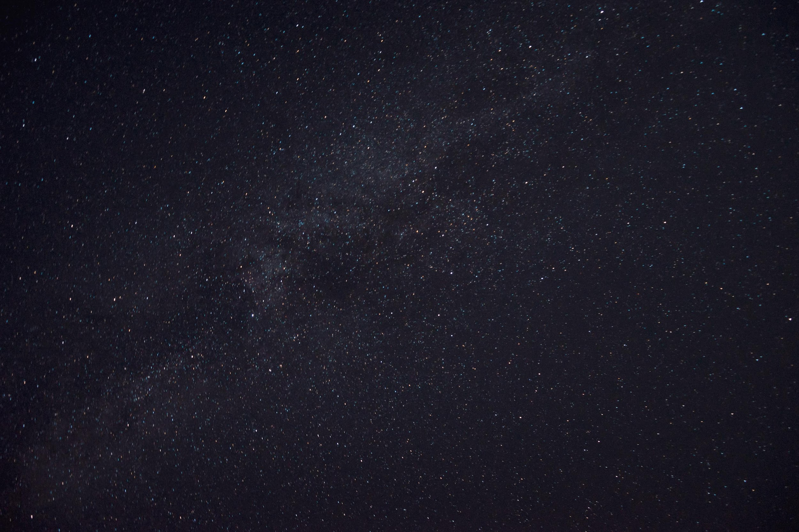
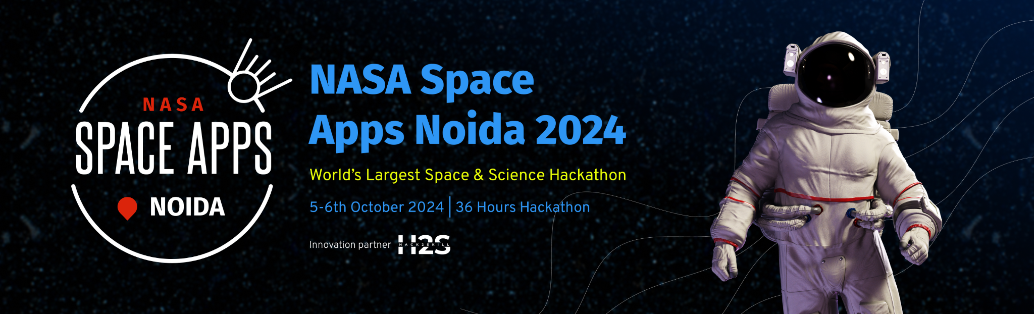
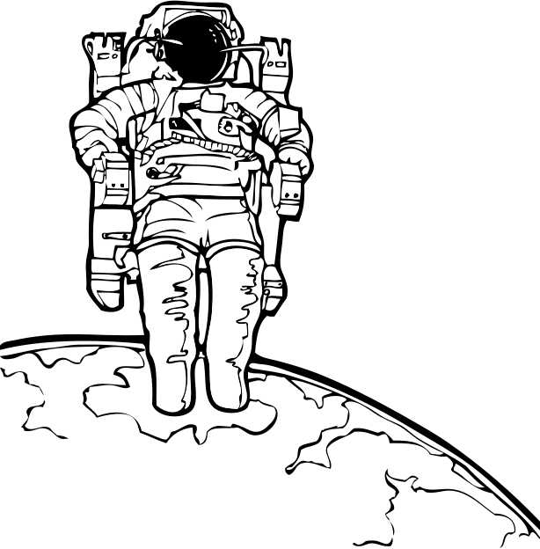
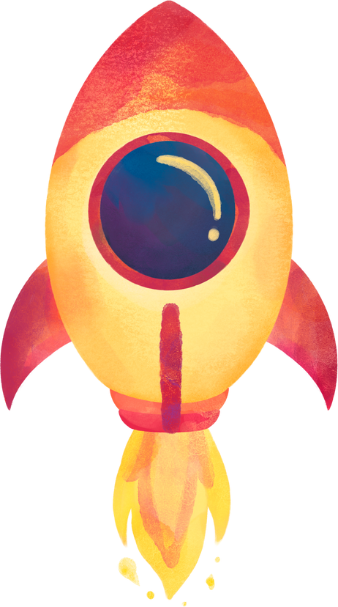
Team Details
Team name: Spacez
Team leader name: Tushar Pandey
Problem Statement: GLOBE Protocol Games

Slide 2
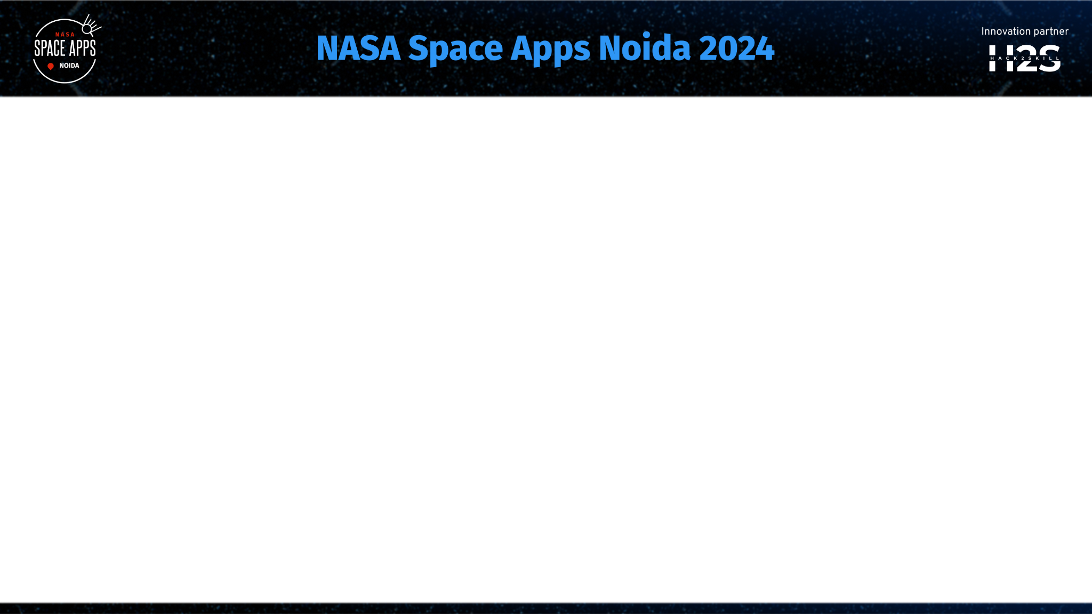
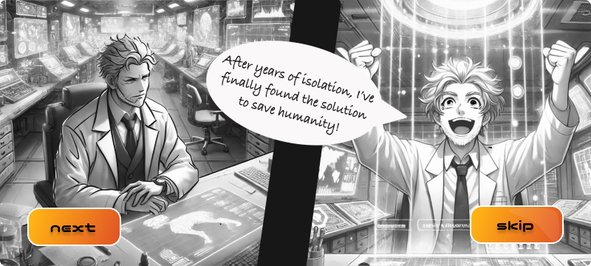
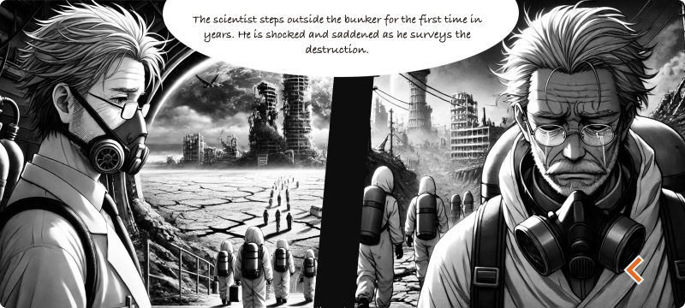
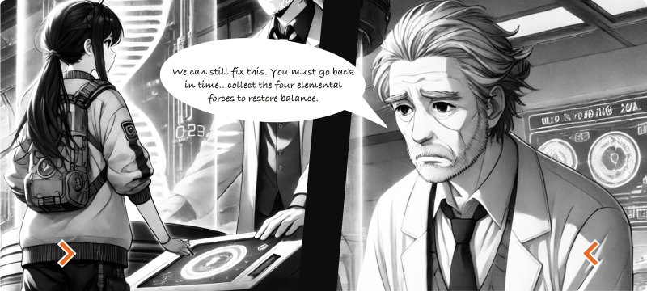
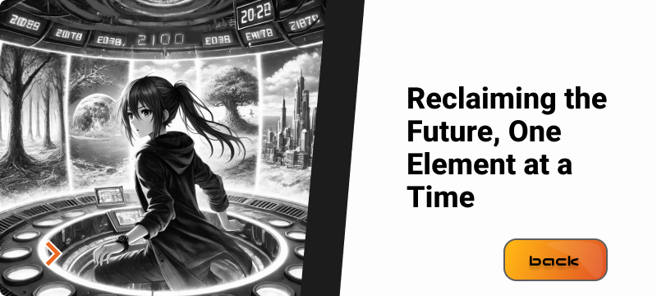

Slide 3


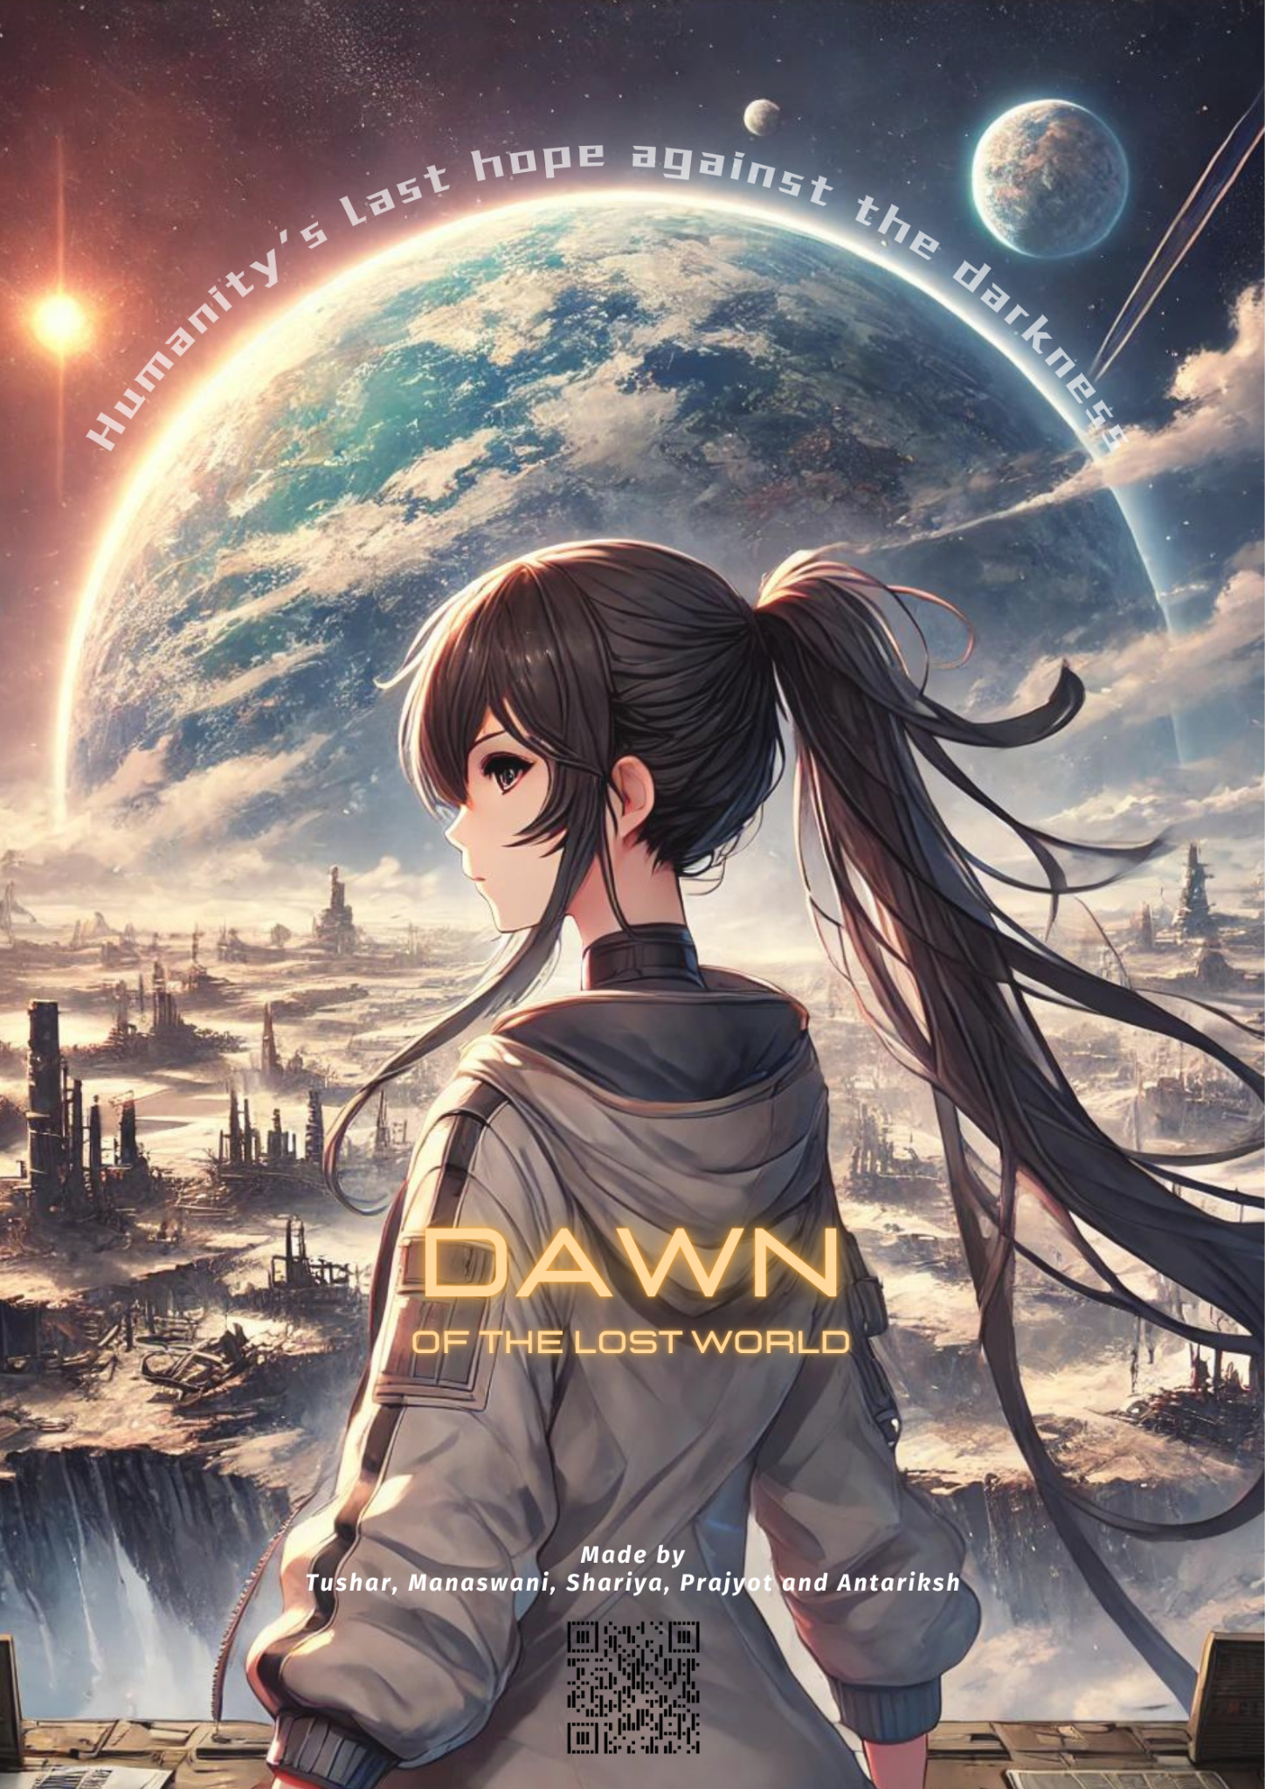

PRESENTATION
BRIEF ABOUT THE IDEA
As learning is an integral part of science, we want to encourage this through the mode of gaming. Our idea is based on the method of learning while playing. The game includes GLOBE protocols to help players learn the value of first hand environmental issues.
It is filled with interesting levels, quizzes and interactive interface. It works on the principle of moral, behavioral change and awareness.
NAME OF THE GAME - DAWN: THE LOST WORLD

Slide 4




OPPORTUNITIES
1. How different is it from any of the other existing ideas?
The game caters to the age group of 13+ years, in our research we found out that this age group is a major user of digital interface and are in their prime years of learning about scientific innovations. From various case studies and existing applications there are very few games that cater to the topic of environment and its awareness. Hence this App will fill the much needed gap from learning from books to practically applying it.

Slide 5



OPPORTUNITIES
2. How will it be able to solve the problem?
The learnings from the books are very theoretical and are often inclusive of complex explanations along with difficult vocabulary. With this app we are inculcating a practical and applicable approach towards the concept of environmental awareness. The game includes many levels and addresses each issue of GLOBE protocol, making learning accessible and inclusive.

Slide 6


OPPORTUNITIES
LIST OF FEATURES OFFERED BY THE SOLUTION
3. USP of the proposed solution.
Engaging storyline
Relatable characters
Quizzes
Real life problem solving
Easy to navigate UI
Collectables
Learning while gaming
The various features included in the game:
Multi-level single player game
Various biomes across diverse environments
Scoreboard and profile screen
Hidden Hints/Clues across the game regarding GLOBE
Level barriers accompanied by quizzes to remove them.
Can Collect Elementals from each biome

Slide 7

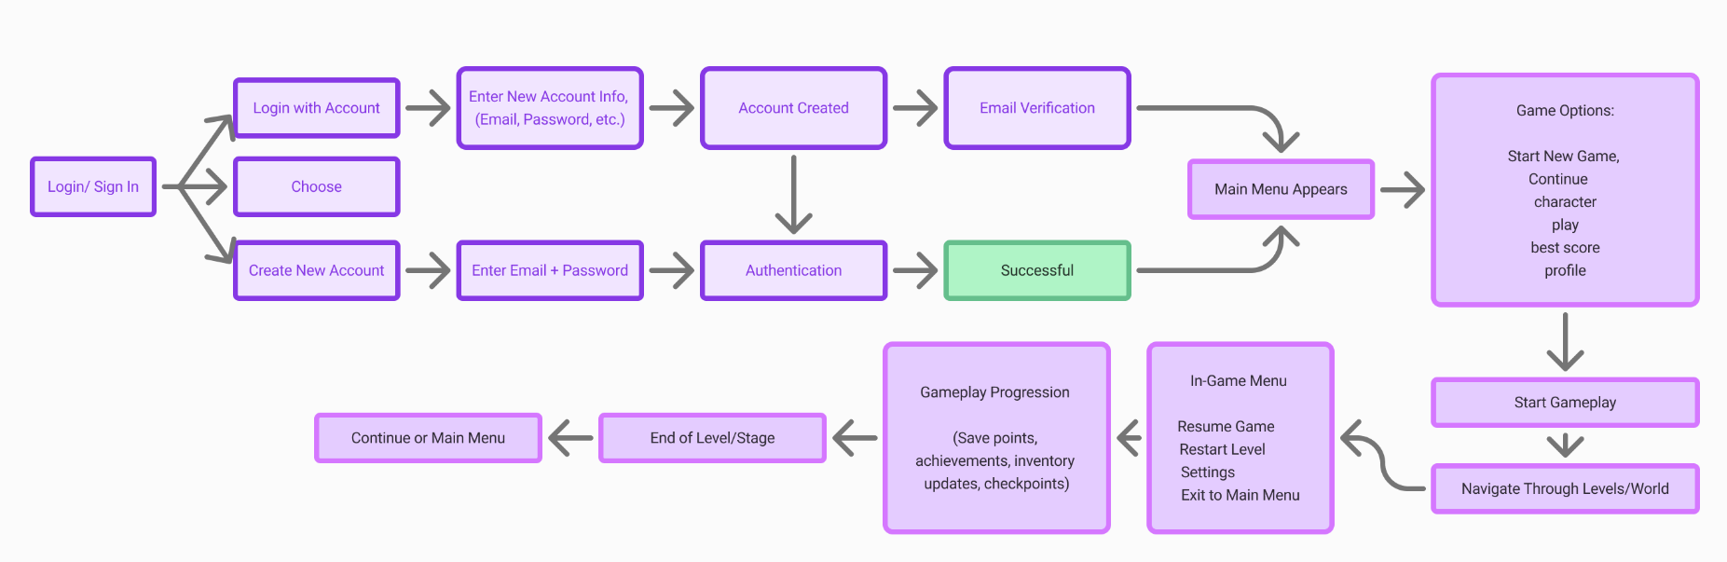

PROCESS FLOW DIAGRAM

Slide 8
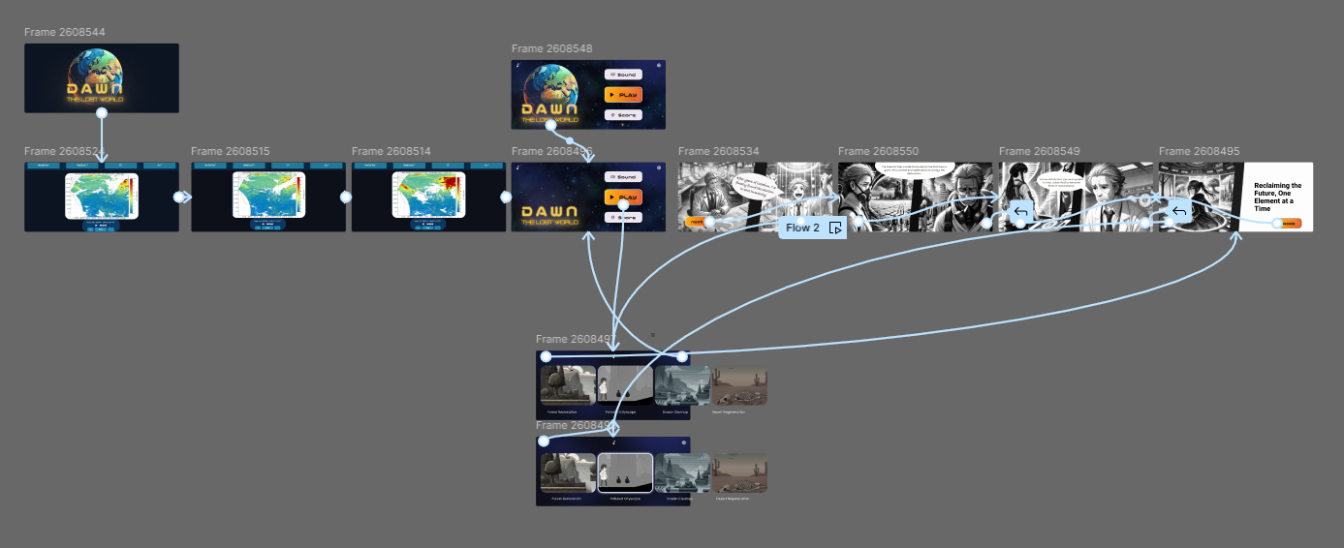
WIREFRAMES OF THE PROPOSED SOLUTION

Slide 9
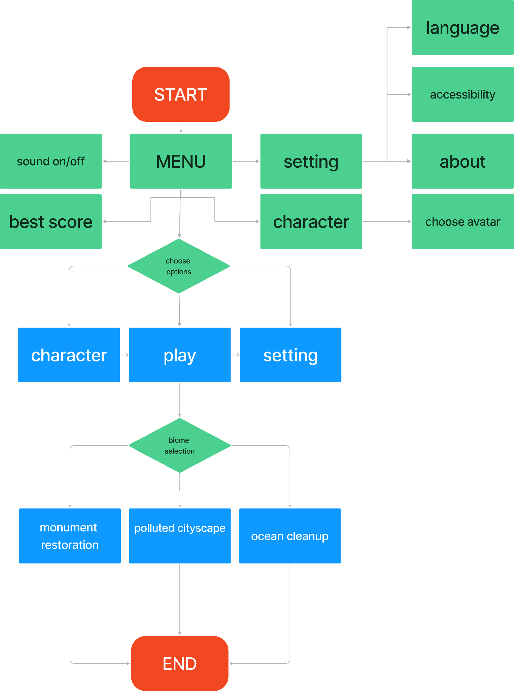
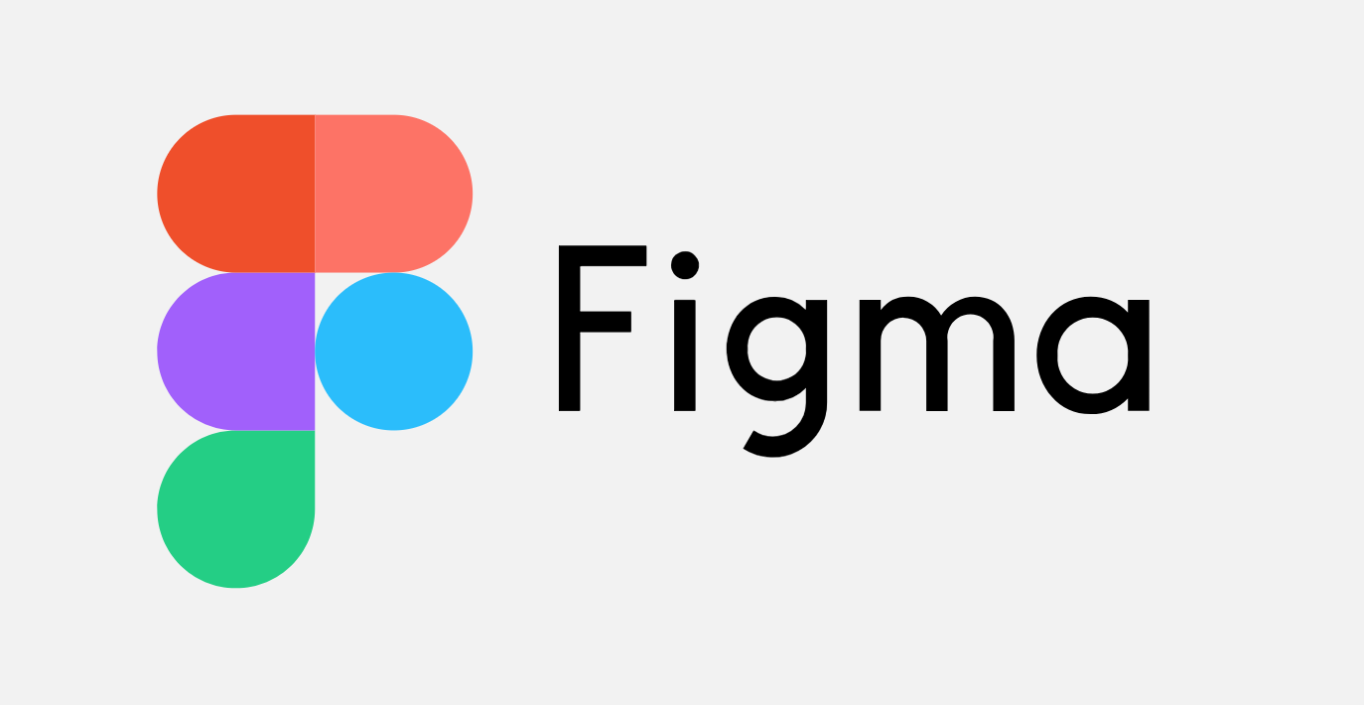




ARCHITECTURE DIAGRAM
TECHNOLOGIES USED
UI integration in Figma
Prototyping in Figma
C# for development
Unity 2D for game development
Image processing with the help of AI

Slide 10
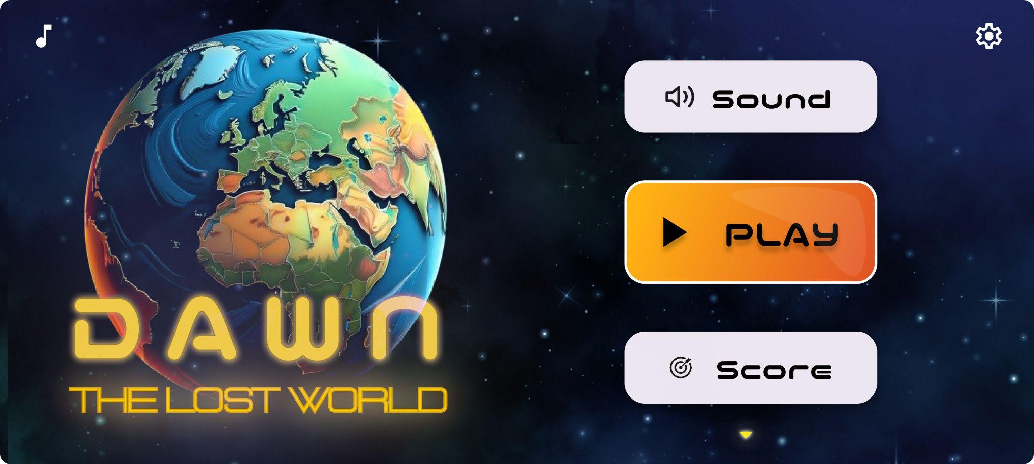
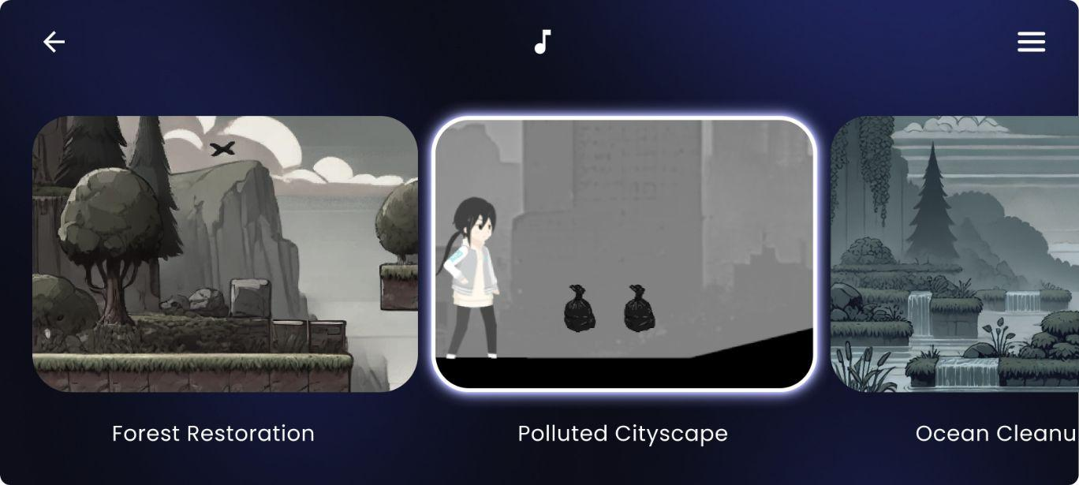
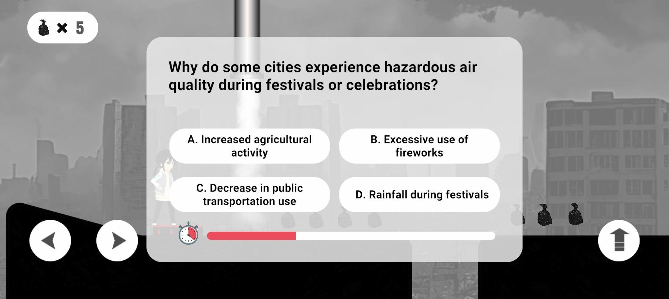
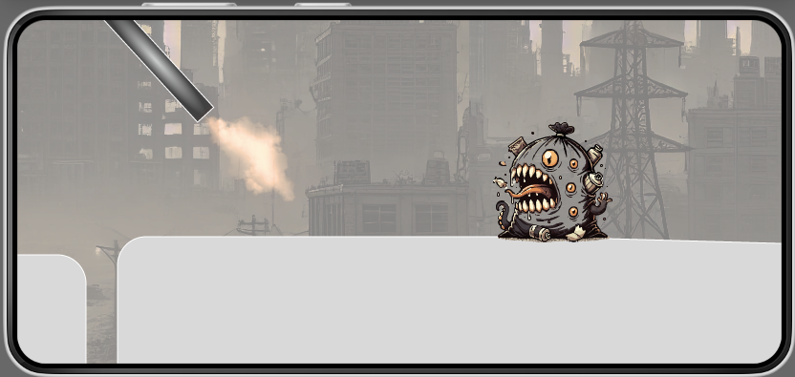
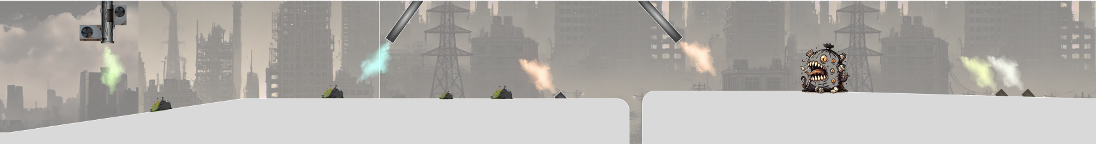
SNAPSHOTS OF THE PROTOTYPE
Main Menu: Access gameplay, character customization, and settings.
Biome Selection Screen: Choose an environmental biome to explore and restore, including Polluted Cityscape, Monument Restoration, and Ocean Clean.
Quiz Screen: Answer environmental science questions based on GLOBE protocols to progress through the game and reinforce learning.
Pollution Monster Encounter: A creature formed from toxic waste and pollution, representing the environmental damage in the polluted biome.
Industrial Hazard: Navigate through a polluted city environment filled with harmful emissions from industrial machinery solving through our mini games.

Slide 11
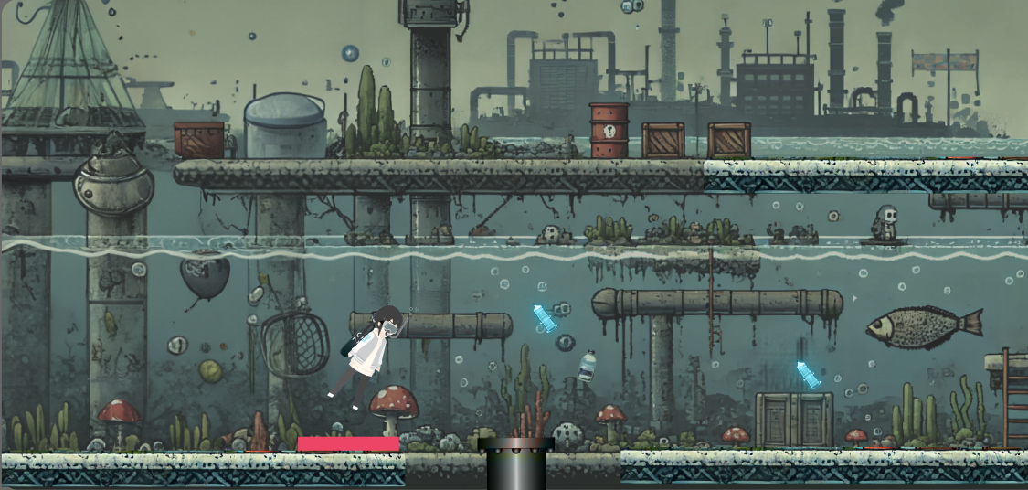
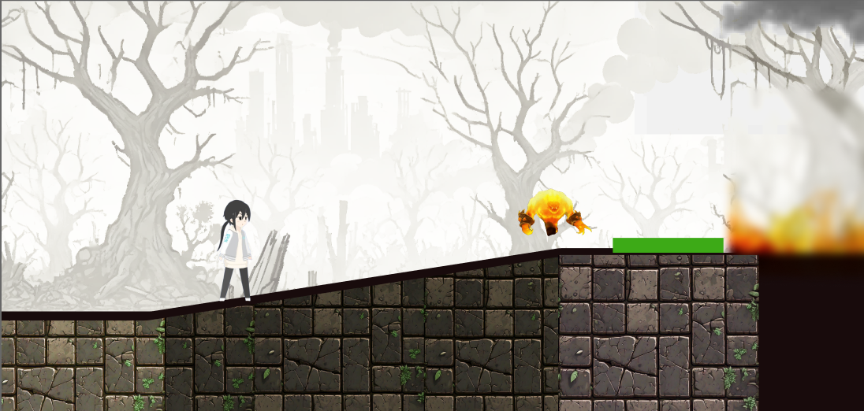
SNAPSHOTS OF THE PROTOTYPE
Toxic Waters: Navigate a polluted underwater environment filled with harmful chemicals, debris, and leaking barrels, dodging toxic waste and hazardous obstacles.
Flaming Forest: Navigate a forest engulfed in damage and dried ruins of its remains after the forest fires emerged and destroyed the areas. Run through the fire monster and save the planet.

Slide 12
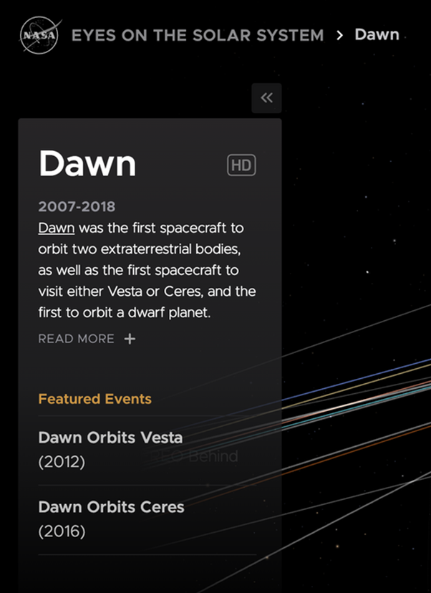
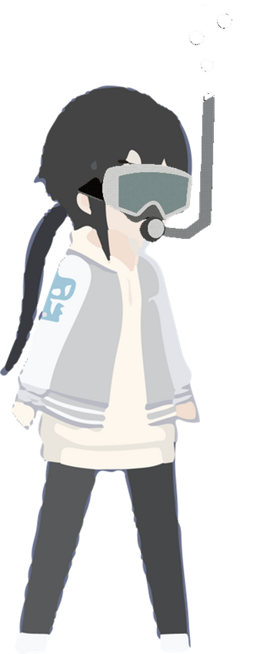
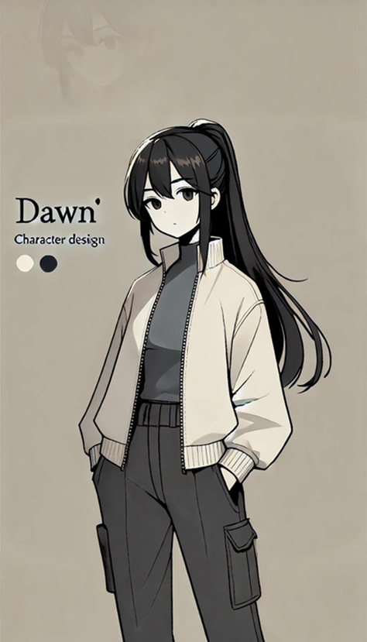
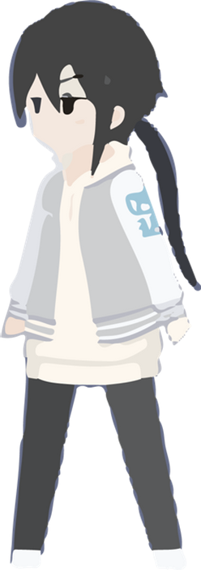
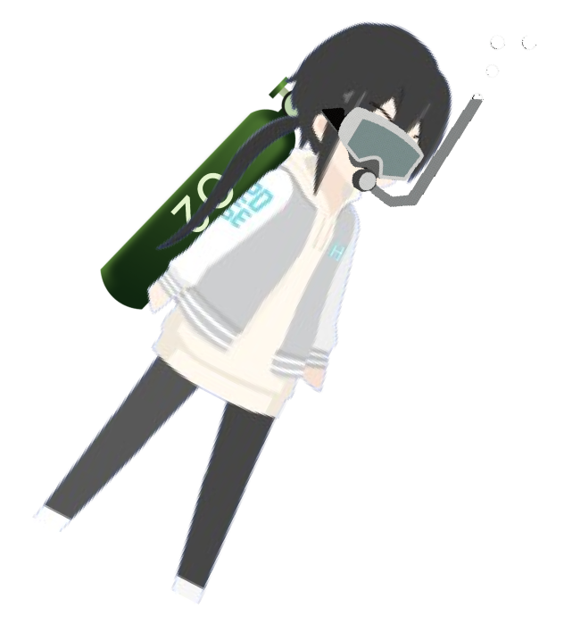
CHARACTERS AND COLLECTABLES
MAIN CHARACTER
Dawn /dɔːn/ noun the first appearance of light in the sky before sunrise.

Slide 13





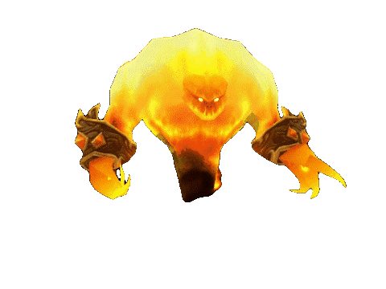

CHARACTERS AND COLLECTABLES
COLLECTABLES
MONSTERS

Slide 14
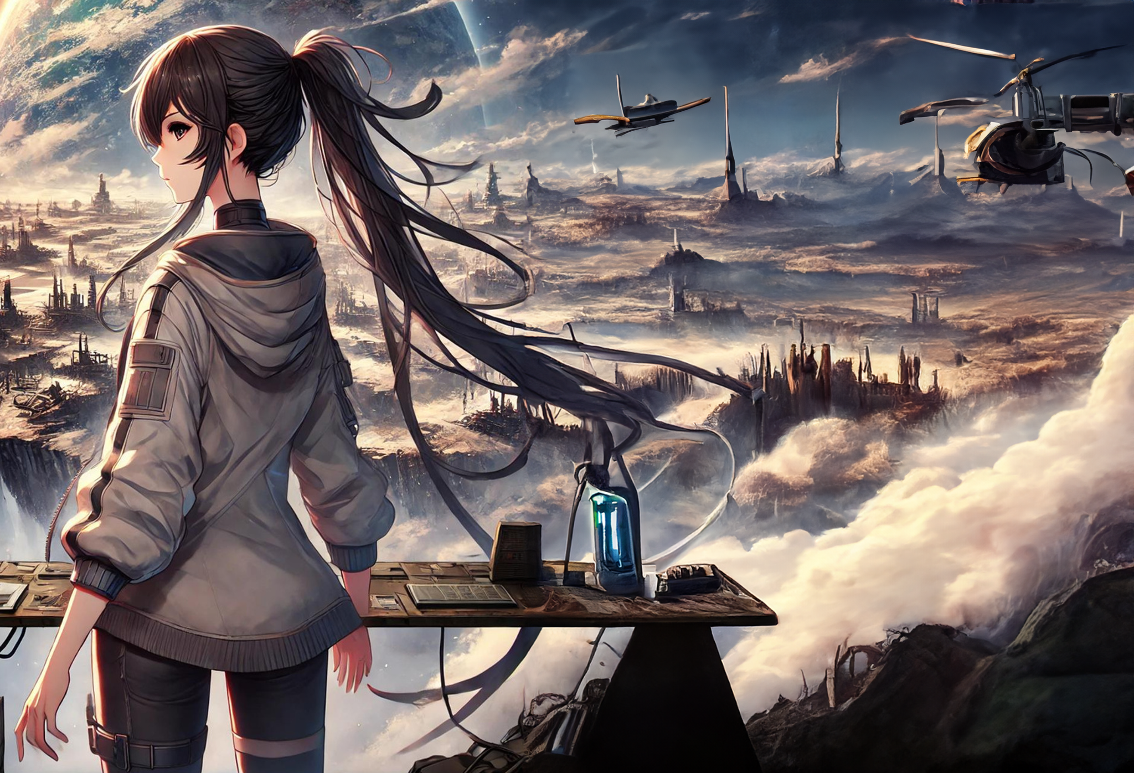

A LOOK AT THE FUTURE
Incorporating sound effects (SFX)
Incorporating additional biomes
Incorporating additional interactions and controls
Levels Of Difficulty
Adding more actions and movements for the main character
More collectables
Play across the world and compete
The dawn of disaster is upon us and you're our only hope. Are you ready to take on the ultimate challenge and save our planet? Step into the game, and let the fight for Earth's survival begin! Will you answer the call?

Slide 15
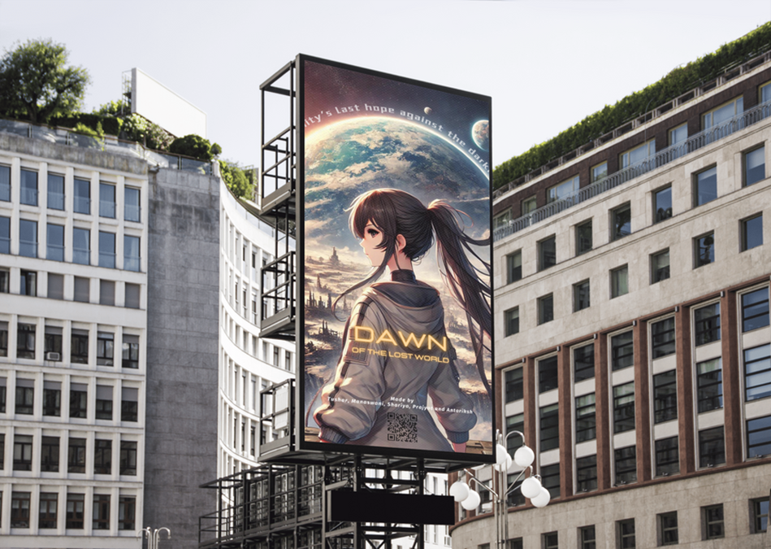
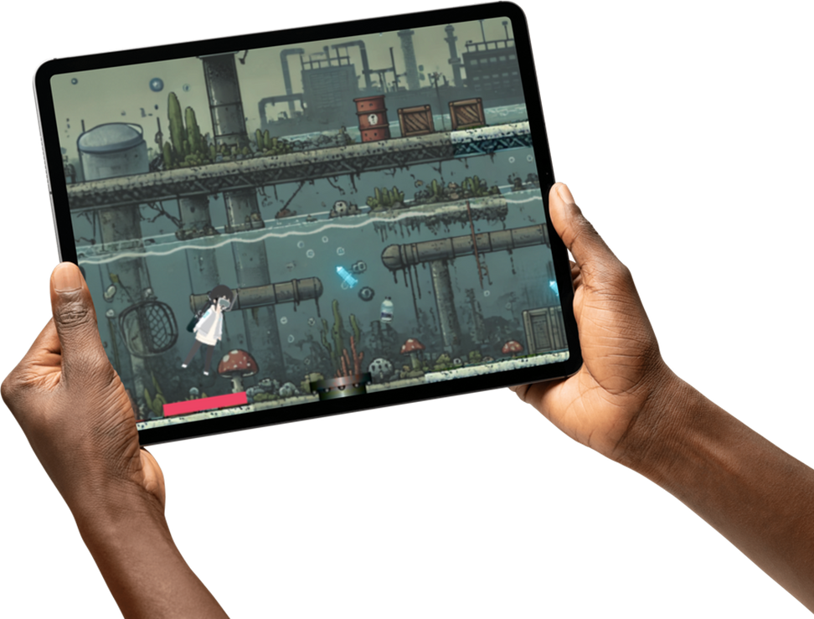
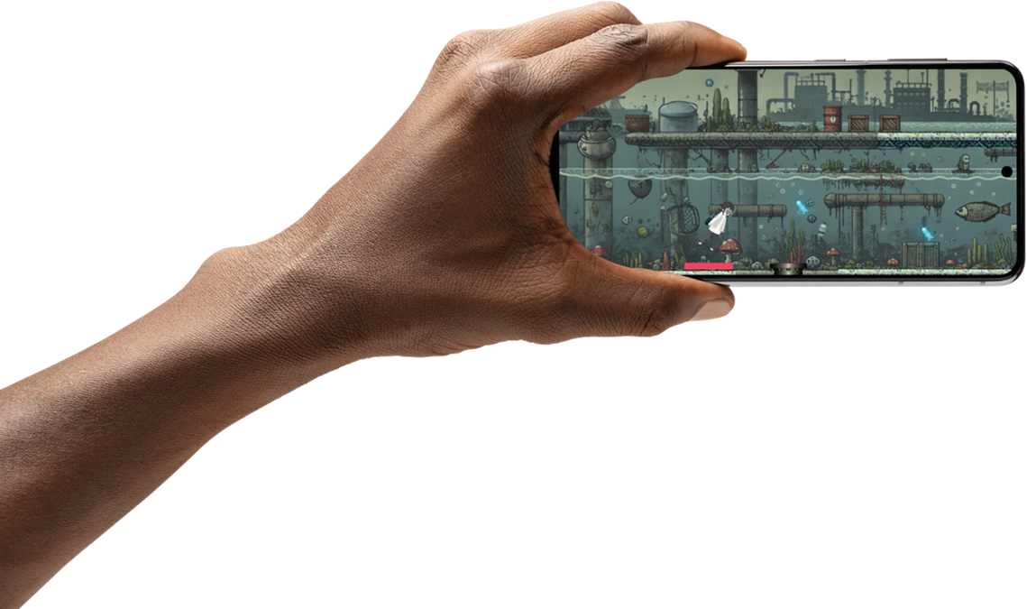
LAUNCHING SOON…
DOWNLOAD FOR YOUR MOBILE AND TABLET!

Slide 16
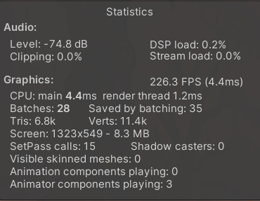
Prototype Performance report/Benchmarking

Slide 17
LINKS OF THE PROJECT
GitHub Public Repository :
https://github.com/prajyotgorlewar/NasaApp
Demo Video Link (3 Minutes) :
https://docs.google.com/presentation/d/1koVYL0SBbH4Lt0VA86ZiNupztsewqoYfJRQPKBnoKL4/edit?usp=sharing
Final Product Link : https://docs.google.com/presentation/d/1koVYL0SBbH4Lt0VA86ZiNupztsewqoYfJRQPKBnoKL4/edit?usp=sharing

Slide 18
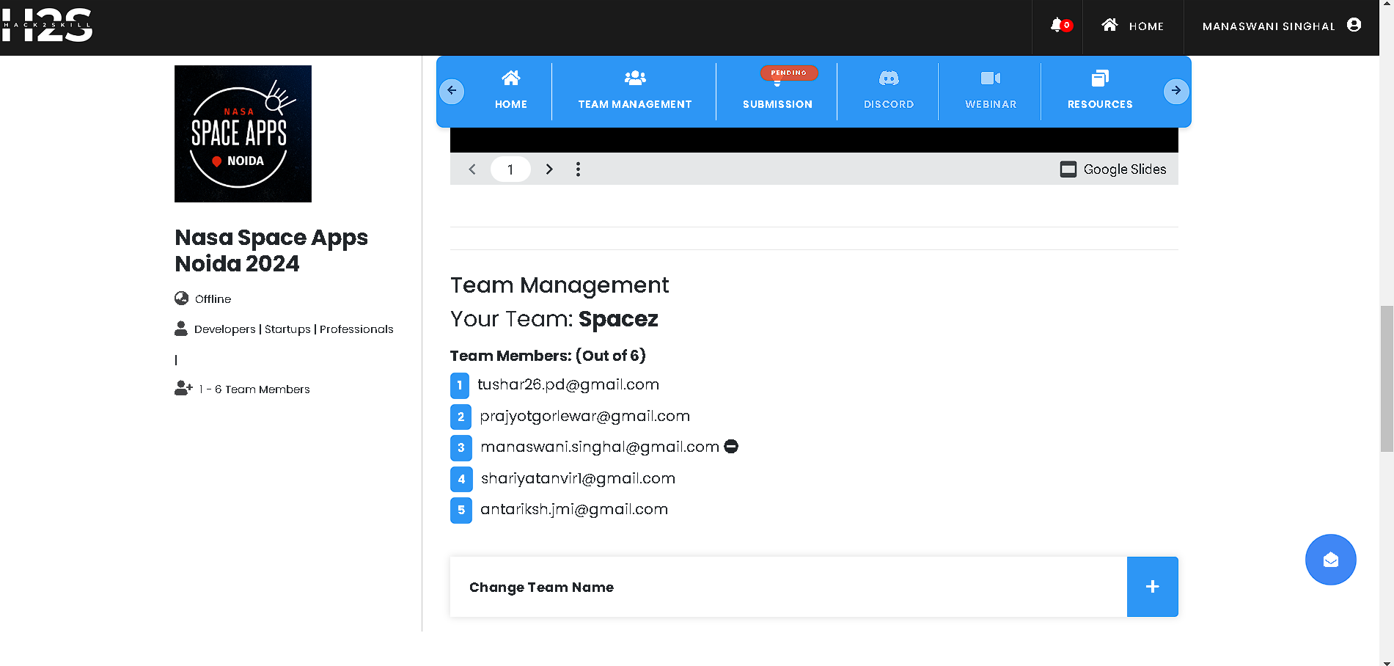
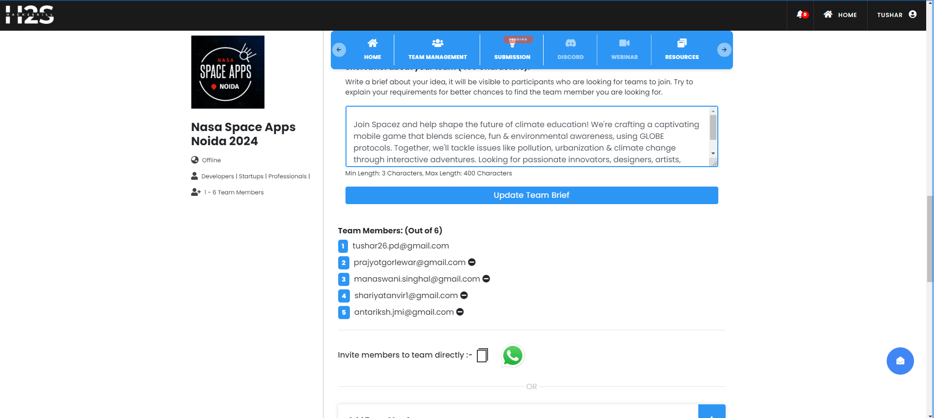
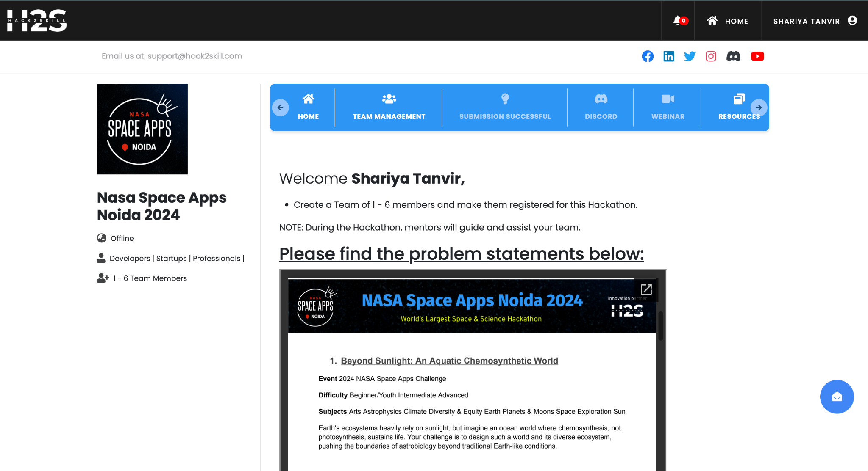
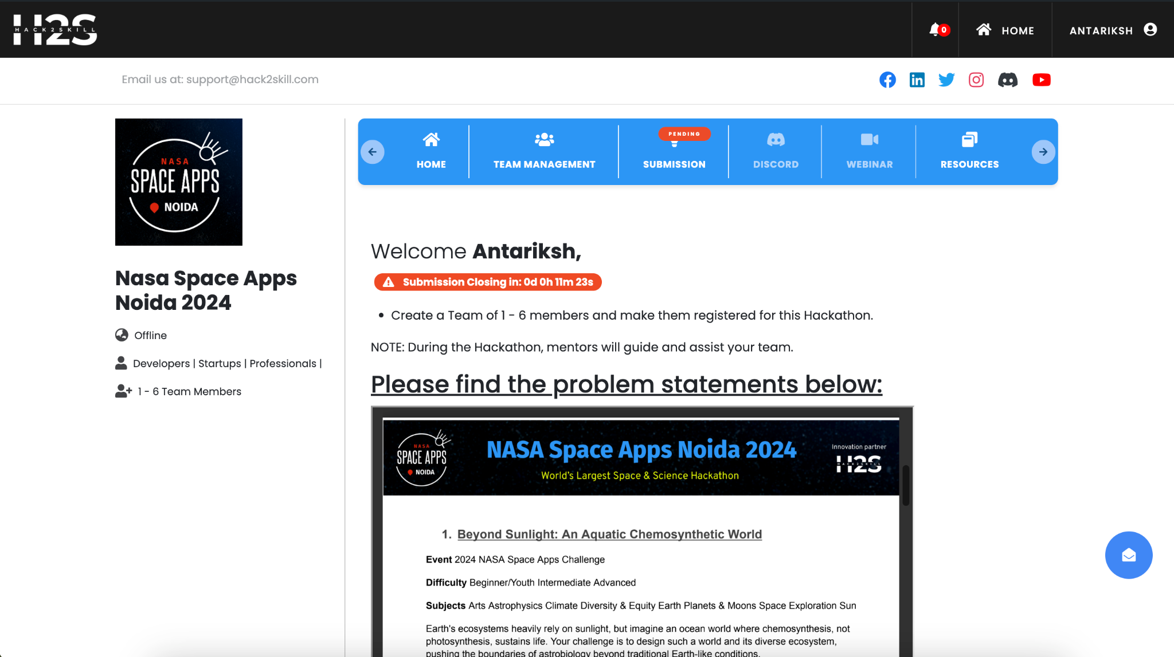
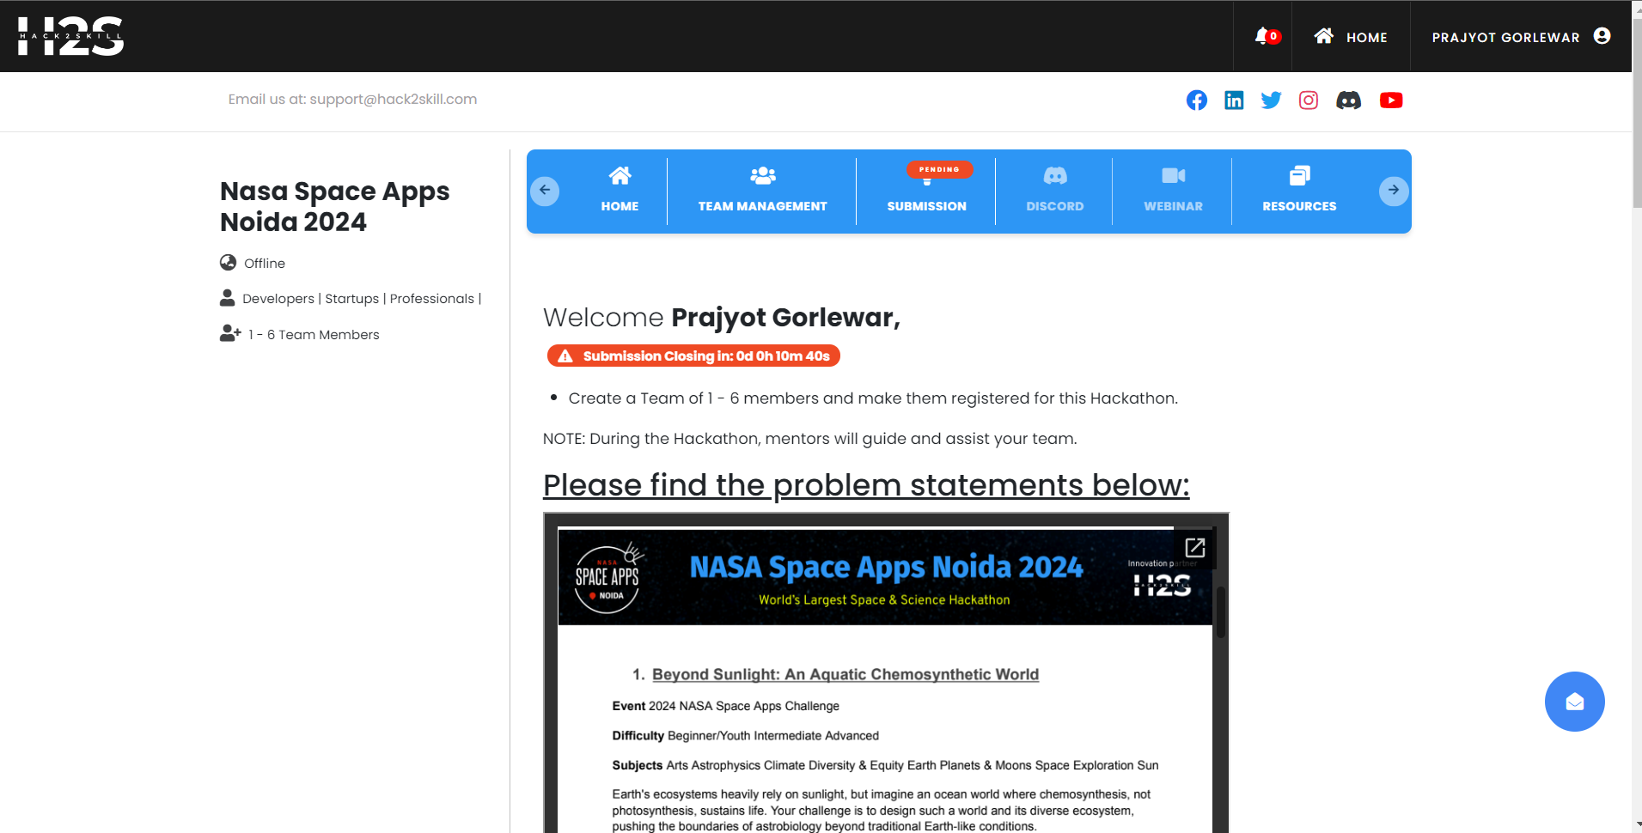
TEAM MEMBERS
Prajyot Gorlewar
Tushar Pandey(L)
Shariya Tanvir
Antariksh Tiwari
Manaswani Singhal

Slide 19
